Slide 1
Digital Portfolio
STUDENT NAME: GOKUL H
REGISTER NO : 20324U09023
NM ID: 098D47DD38CF59D93F94DB51498751B5
DEPARTMENT: BCA
COLLEGE: Dr. M. G. R. CHOCKALINGAM ARTS COLLEGE
UNIVERSITY: THIRUVALLUVAR UNIVERSITY

Slide 2
PROJECT TITLE
STUDENT DIGITAL PORTFOLIO WEBSITE USING WEB DEVELOPMENT (HTML, CSS, AND JAVASCRIPT)

Slide 3


AGENDA
Problem Statement
Project Overview
End Users
Tools and Technologies
Portfolio design and Layout
Features and Functionality
Results and Screenshots
Conclusion
Github Link
3/21/2024 Annual Review

Slide 4
PROBLEM STATEMENT
In an increasingly digital world, a static resume often falls short. Students need a dynamic, accessible platform to present their skills, projects, and unique personality to potential employers, collaborators, or academic institutions.
Limited Reach | Show, Don't Tell | Personal Branding
Traditional resumes lack visual impact and global accessibility. | Projects are best understood through live examples, not just descriptions. | A digital presence allows for a unique, memorable professional identity

Slide 5

PROJECT OVERVIEW
Our goal is to build a highly customizable, responsive, and interactive digital portfolio website. This platform will serve as a central hub for students to highlight their academic achievements, personal projects, and professional aspirations.
Define Purpose Clarify what the portfolio needs to achieve (job applications, academic admissions, freelance work). | Content Curation Select compelling projects, experiences, and testimonials.
Technical Development Implement design and functionality using core web technologies. | Deployment & Maintenance Make the portfolio live and ensure its ongoing relevance.

Slide 6

WHO ARE THE END USERS?
Understanding the audience is crucial for effective portfolio design. Each user group has specific needs and expectations when viewing a student's work.
Prospective Employers Seek direct evidence of skills, problem-solving abilities, and fit for roles. Look for clarity, easy navigation, and relevant project examples. | Academic Institutions Evaluate potential students' creativity, research capabilities, and commitment to their field of study. Academic portfolios may emphasize theoretical understanding and detailed methodologies. | General Public/Network Curiosity-driven visitors interested in personal projects or seeking contact for general inquiries. A clear "About Me" section and contact info are key.

Slide 7
TOOLS AND TECHNIQUES
Building a robust digital portfolio relies on fundamental web development technologies. These tools provide the flexibility and power needed for a customized and interactive experience.
HTML5: Structure
The backbone of the website, defining content organization and semantics. Used for creating sections like About Me, Projects, Skills, and Contact.
CSS3: Style
Provides visual styling, layout, and responsiveness. Crucial for creating an appealing and professional aesthetic that adapts to various screen sizes.
JavaScript: Interactivity
Adds dynamic behavior, animations, form validation, and interactive elements, enhancing user engagement and experience.
Version Control (Git)
Essential for managing code changes, collaborating, and deploying the site to platforms like GitHub Pages.

Slide 8
POTFOLIO DESIGN AND LAYOUT
A strong design ensures a positive user experience and effectively communicates the student's brand. Focus on clean aesthetics, intuitive navigation, and mobile-first responsiveness.
Minimalist Aesthetic Clean lines, ample whitespace, and a limited color palette (including brand colors like #E1E1DF) to keep focus on the content. | Intuitive Navigation Clear menus, logical sections, and easy access to key information like contact details and project categories.
Responsive Design Ensuring the portfolio looks great and functions perfectly on desktops, tablets, and mobile phones. | Visual Hierarchy Using typography, spacing, and imagery to guide the user's eye to the most important information first.
8

Slide 9
FEATURES AND FUNCTIONALITY
Beyond static content, a modern digital portfolio incorporates interactive elements to truly impress visitors and convey skills.
Project Showcase | Detailed project pages with images, videos, descriptions, and links to live demos/repositories.
Dynamic Skill Bars | Interactive visual representations of proficiency in different programming languages or tools using JavaScript.
Contact Form | Functional form for direct inquiries, with client-side validation using JavaScript.
Lazy Loading Images | Optimize performance by loading images only when they enter the viewport using JavaScript.
Smooth Scrolling | Enhanced navigation experience through JavaScript-powered smooth transitions to anchor links.

Slide 10

RESULTS AND SCREENSHOTS
Project Showcase | Detailed project pages with images, videos, descriptions, and links to live demos/repositories.
Dynamic Skill Bars | Interactive visual representations of proficiency in different programming languages or tools using JavaScript.
Contact Form | Functional form for direct inquiries, with client-side validation using JavaScript.
Lazy Loading Images | Optimize performance by loading images only when they enter the viewport using JavaScript.
Smooth Scrolling | Enhanced navigation experience through JavaScript-powered smooth transitions to anchor links.
10

Slide 11
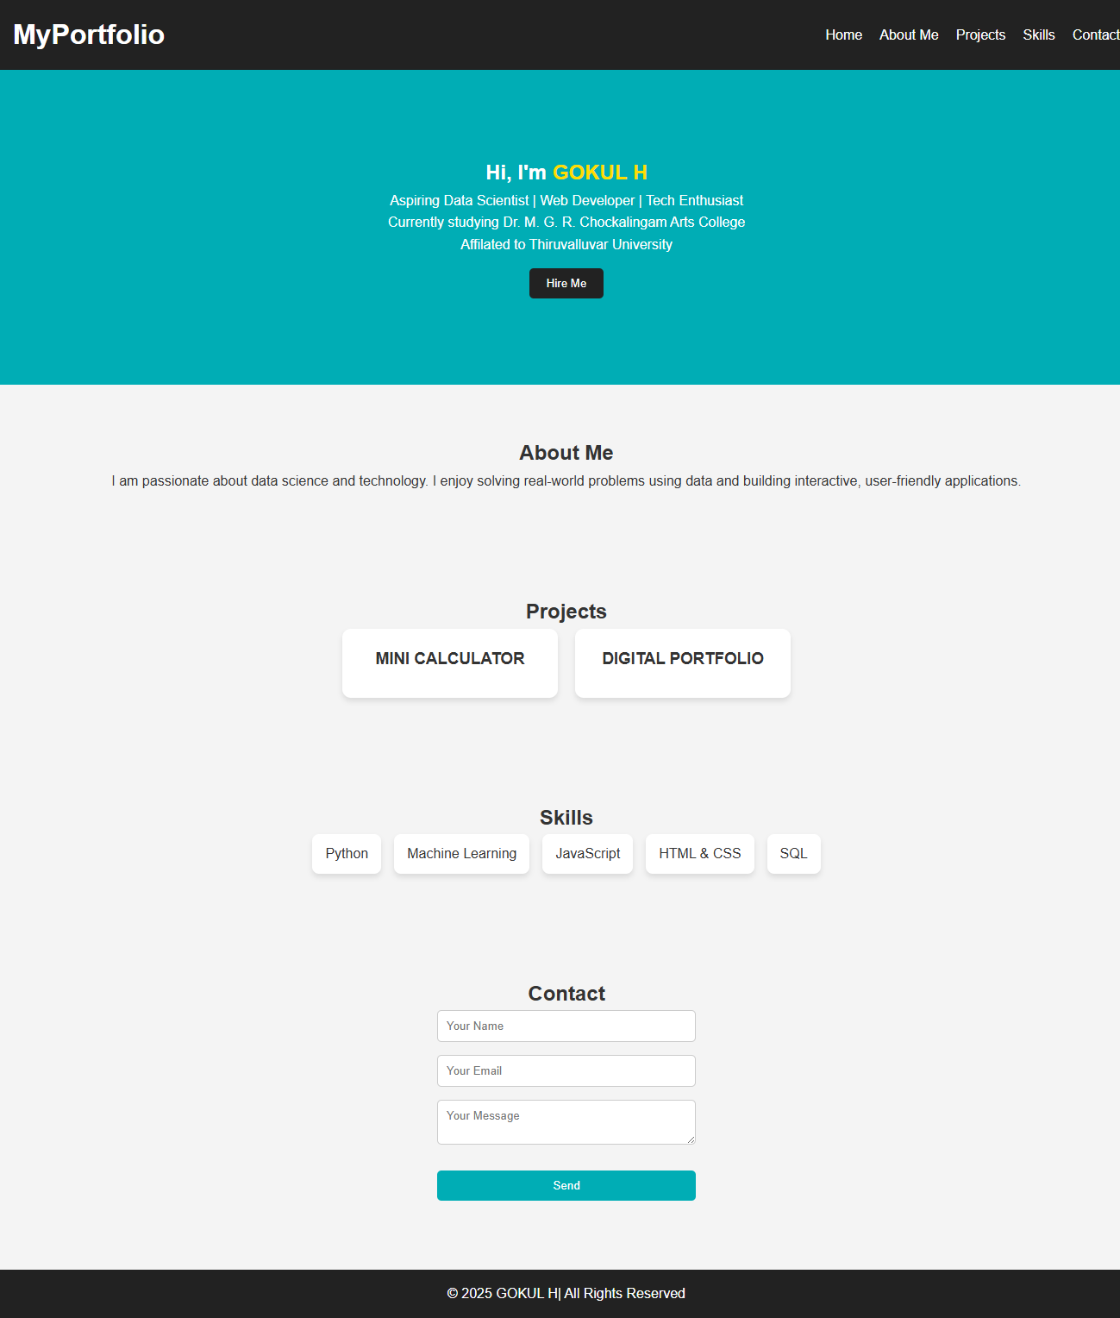
SCREENSHOT

Slide 12
CONCLUSION
A well-crafted digital portfolio is more than just a website; it's a living resume and a testament to a student's capabilities. By leveraging HTML, CSS, and JavaScript, students can create a compelling online presence that opens doors to new opportunities.
Project Showcase | Detailed project pages with images, videos, descriptions, and links to live demos/repositories.
Dynamic Skill Bars | Interactive visual representations of proficiency in different programming languages or tools using JavaScript.
Contact Form | Functional form for direct inquiries, with client-side validation using JavaScript.
Lazy Loading Images | Optimize performance by loading images only when they enter the viewport using JavaScript.
Smooth Scrolling | Enhanced navigation experience through JavaScript-powered smooth transitions to anchor links.
12

Slide 13
GITHUB LINK
https://github.com/Gokul-H-01/Digital-Portfolio.git

